Slide 1









GROUP
PROJECT
Presented by: Quantum Alliance Group

Slide 2

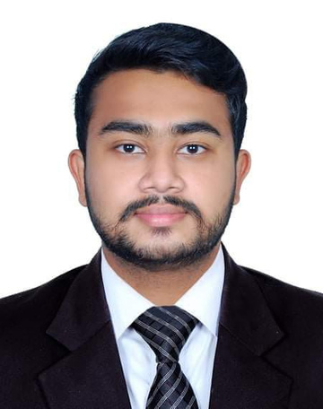

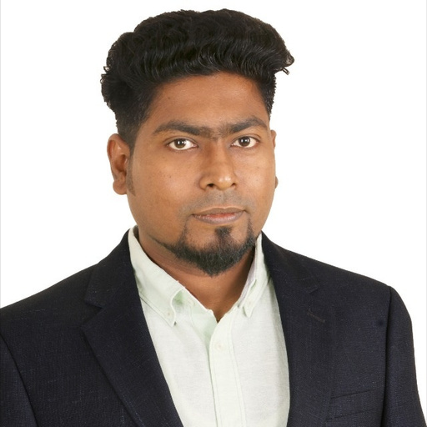
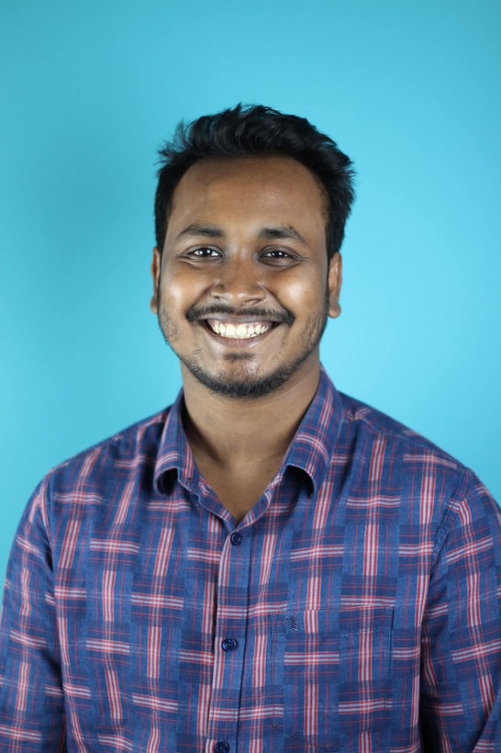

OUR TEAM
Abdun Nafi Rahman
Ekanta Banik
Saber Nasir
Beezan Das
Bondhon Poddar

Slide 3




PROJECT OVERVIEW
Plate Exchange is a web-based application we built for our Web-Based Software Development course. The idea is simple—creating an online platform where people can share, buy, sell or exchange plates with others in the community. We designed the site to be clean, responsive, and user-friendly, so anyone can easily browse, upload, and connect for exchanges.
This project was developed using React and deployed on Vercel, giving us hands-on experience with modern web development tools and deployment processes. Beyond being a technical project, Plate Exchange also promotes a sustainable practice by reducing waste through sharing.

Slide 4

BACKGROUND
Plate Exchange is a full-stack web application designed to facilitate the buying and selling of vehicle number plates. The platform serves as a marketplace where sellers can list their number plates, and buyers can browse and purchase them. The admin dashboard provides administrators with tools to manage listings, users, and transactions.

Slide 5
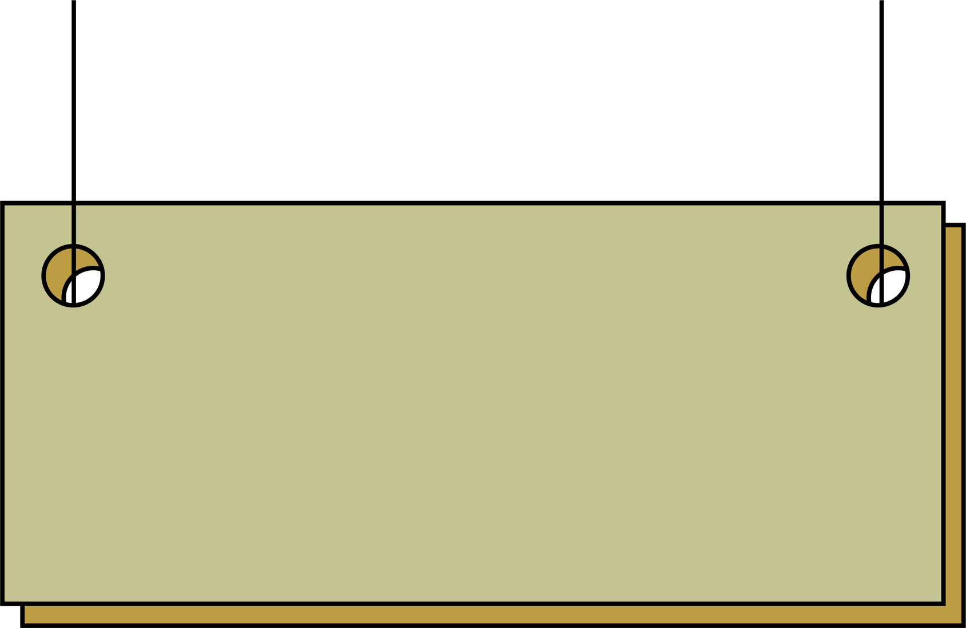
KEY FEATURE
Public Website User Registration & Authentication: Users can create accounts, log in, and manage their profiles. Browse Listings: Users can view available number plates, filter by criteria, and view detailed information. Purchase Process: Users can initiate the purchase of a number plate, including payment processing.

Slide 6
KEY FEATURES
Analytics: Admins have access to analytics on user activity, sales, and other key metrics. Tech Stack Frontend: React (Vite), Tailwind CSS Backend: Node.js, Typescript (TS) Database: PostgreSQL
Authentication: JWT (JSON Web Tokens) Hosting: Vercel

Slide 7
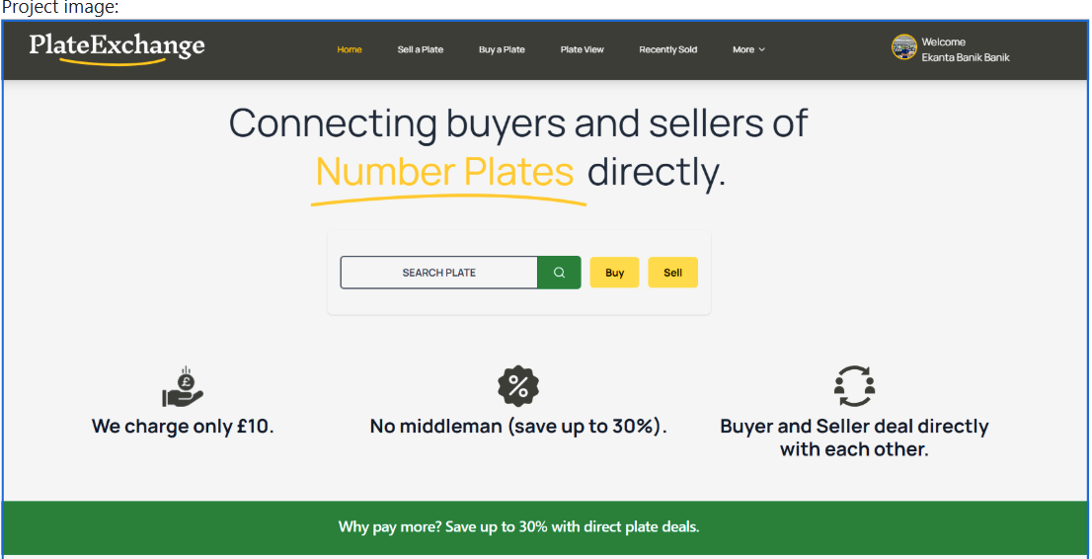
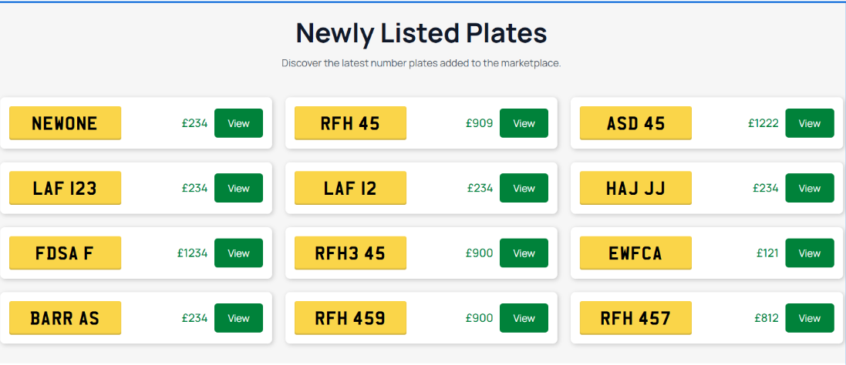
RESULT

Slide 8
CONCLUSION
Plate Exchange gave us hands-on experience in modern web development while addressing a real-life need for sharing and sustainability. It strengthened our technical skills and showed how simple digital solutions can create positive community impact.

Slide 9
THANK YOU

